Slide 1
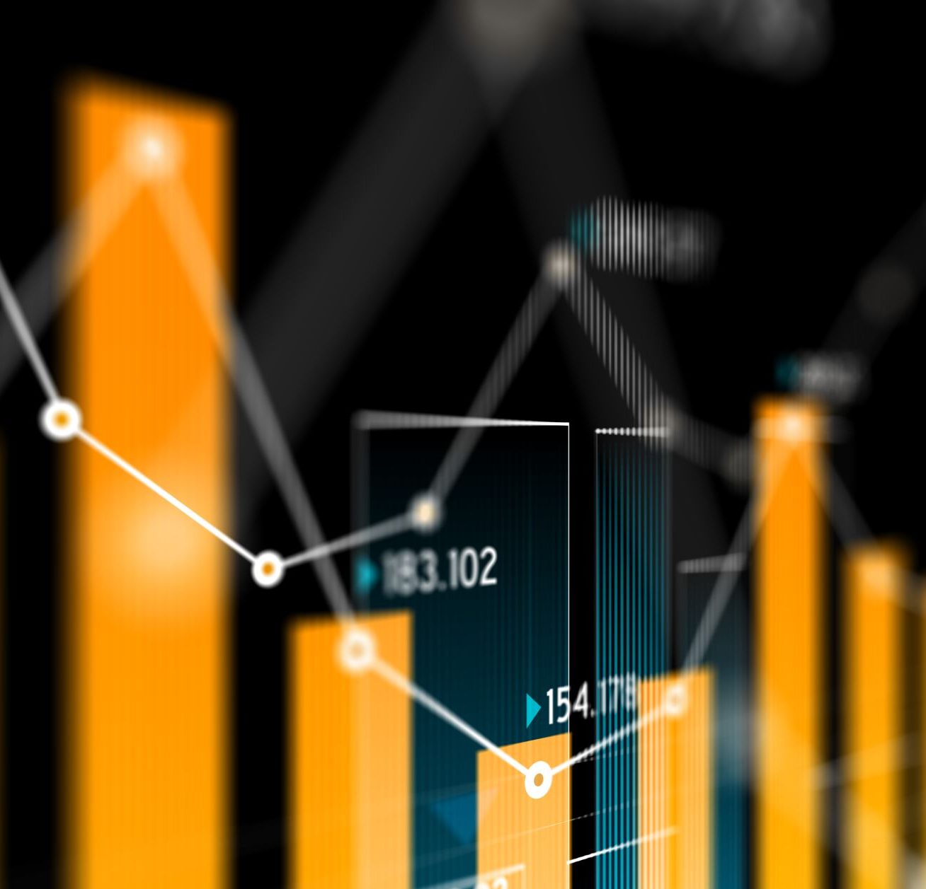
An Analysis of Price Trends and Patterns on Basic Goods in Cyprus from a Data Science Perspective
Andreas Neocleous, Dr. Demetris Trihinas

Slide 2
Contents
Objectives
Relevant Applications
Data Collection
Preprocessing
Exploratory Data Analysis (EDA)
Dashboard

Slide 3
Objectives
Digitalize the basic consumer goods data
Conduct data analysis
Create a dashboard

Slide 4
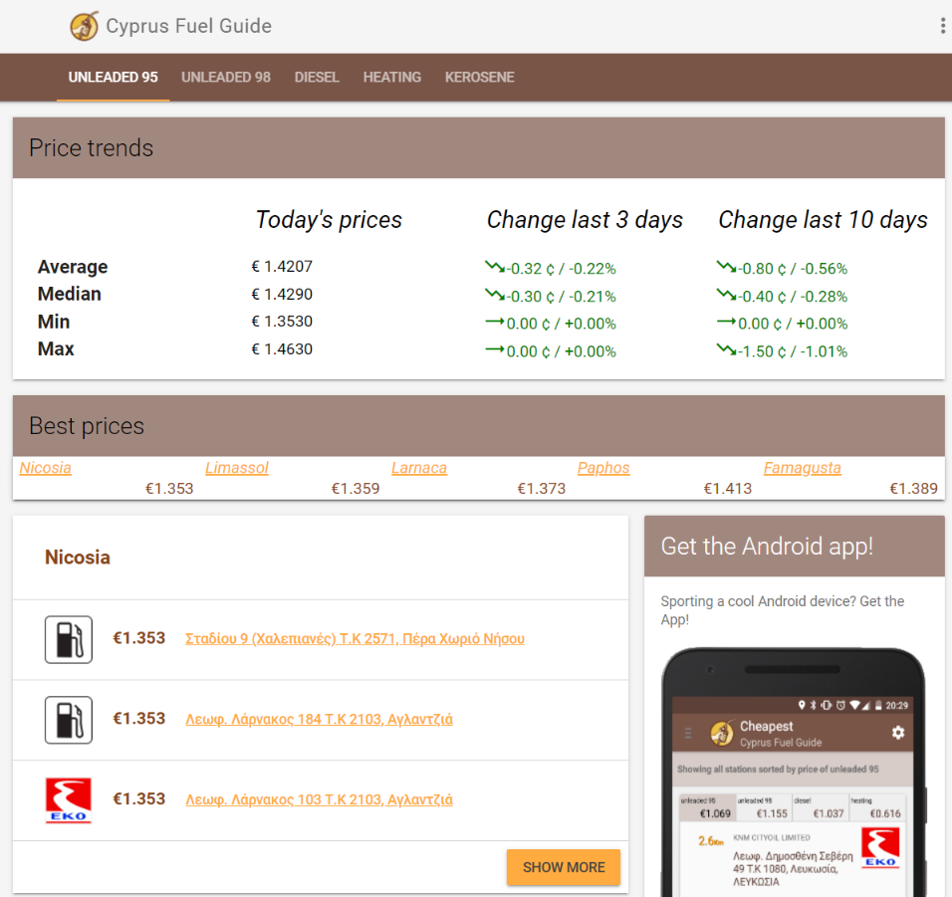
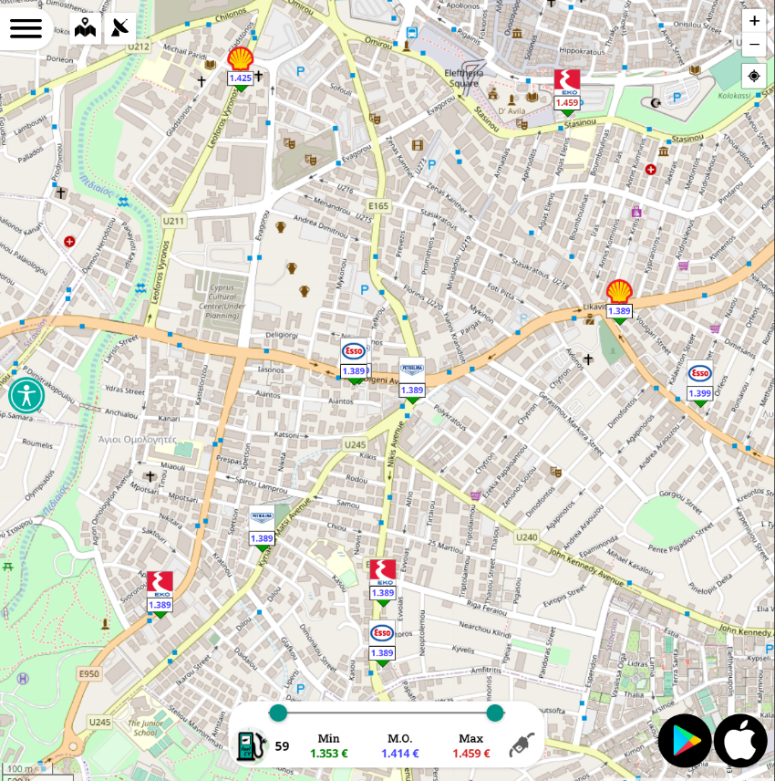
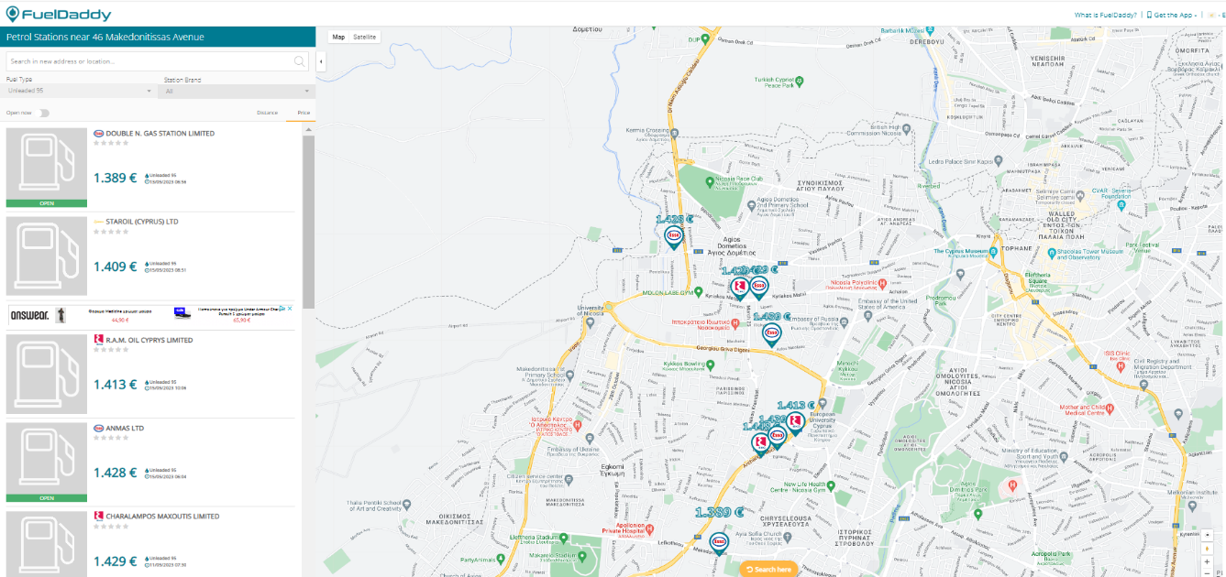
Relevant Applications
Fuel Pricing
Fuel prices increased → Observatories were born
Interactive maps
Regular updates
Expenses optimization

Slide 5
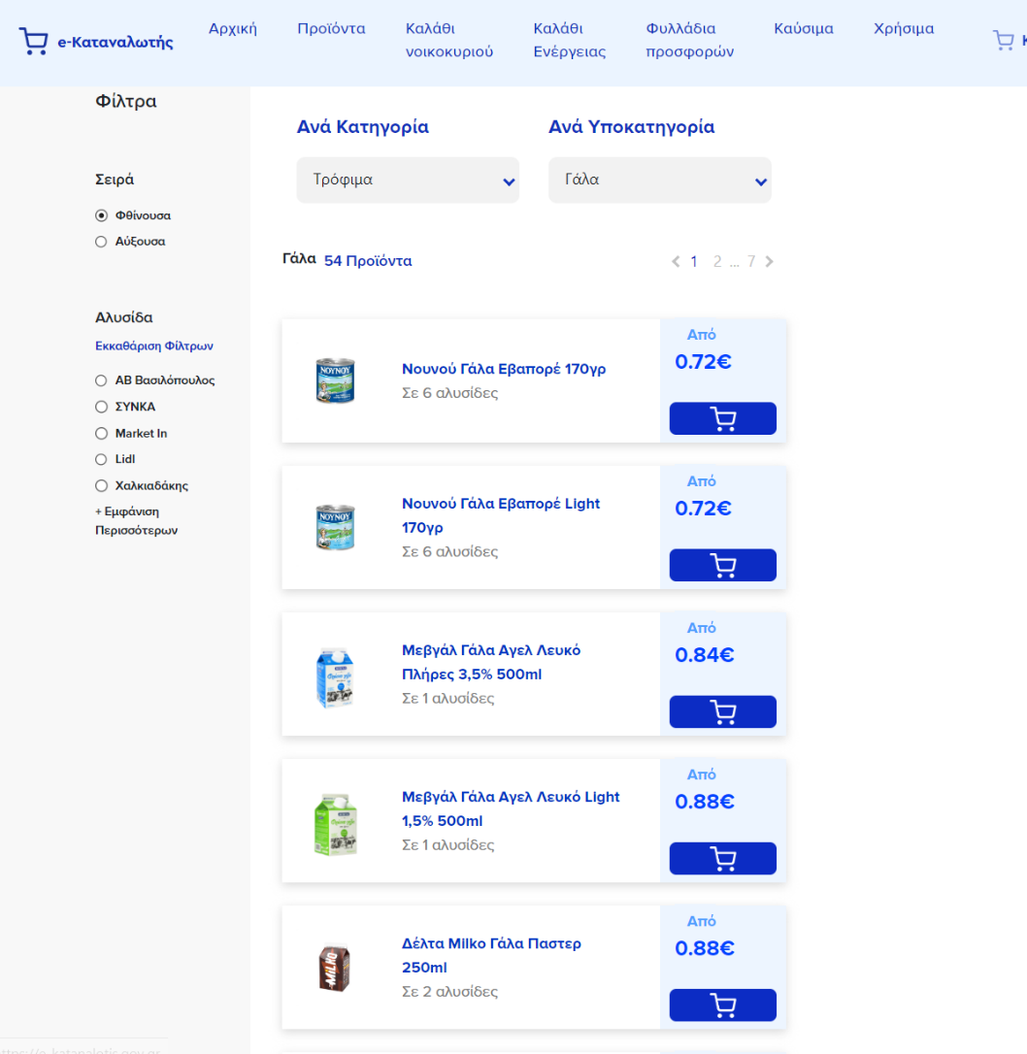
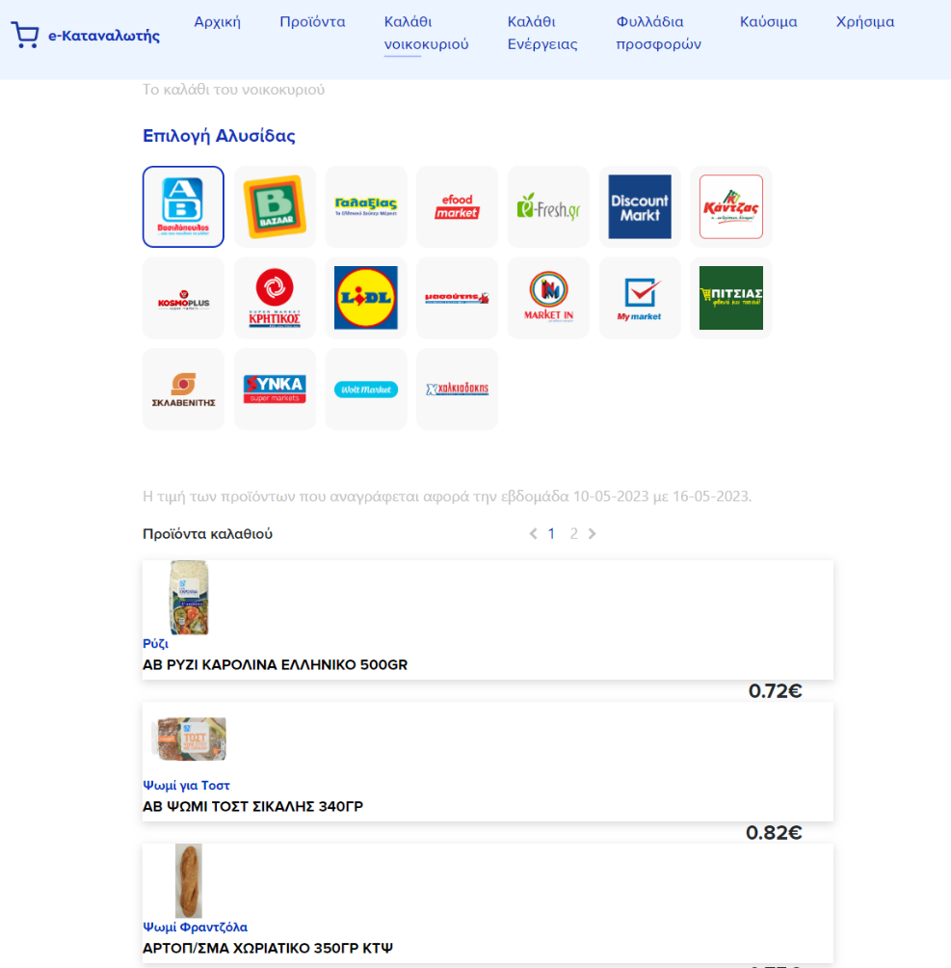
Relevant Applications
e-Katanalotis
Basic Consumer goods prices increased in Greece → Observatory creation
Product prices among different brands
Regular updates
Expenses optimization

Slide 6

Relevant Applications
e-kalathi
Government of Cyprus follows footsteps of Greek government
A total of 350 products are set to be included
Development of e-kalathi started after this project had started.

Slide 7
Data Collection
Source: Online database of Consumer Protection Service, Ministry of Energy, Commerce and Industry
Data divided into divided 4 categories:
Basic Consumer Goods prices observatory (September/2021 – February/2023)
Christmas price observatory (2016-2022)
Easter price observatory (2016-2022)
Green Monday price observatory (2018-2022)
PDF format

Slide 8
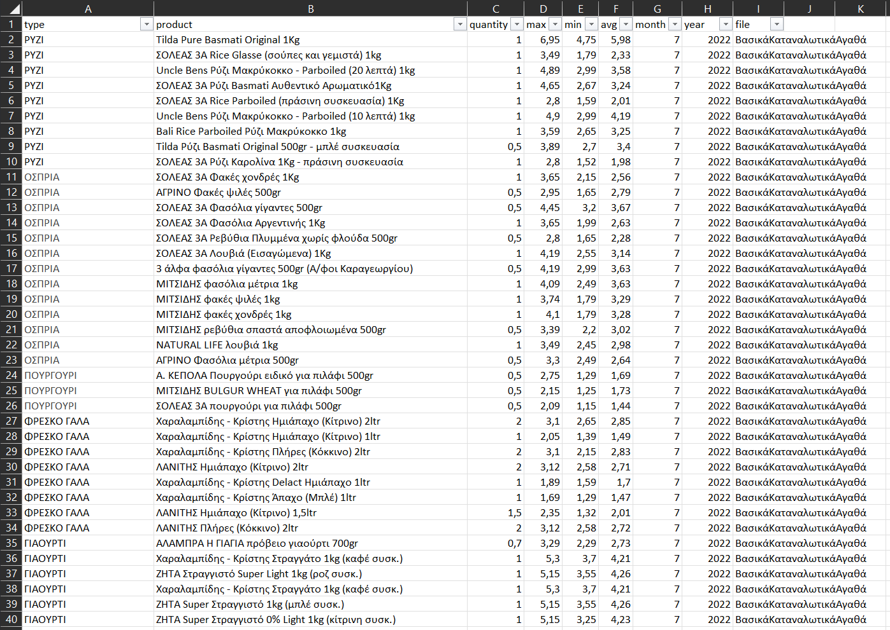
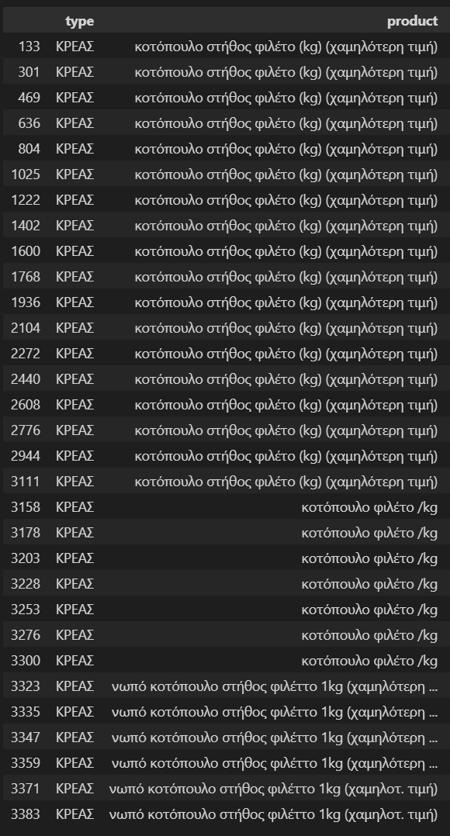
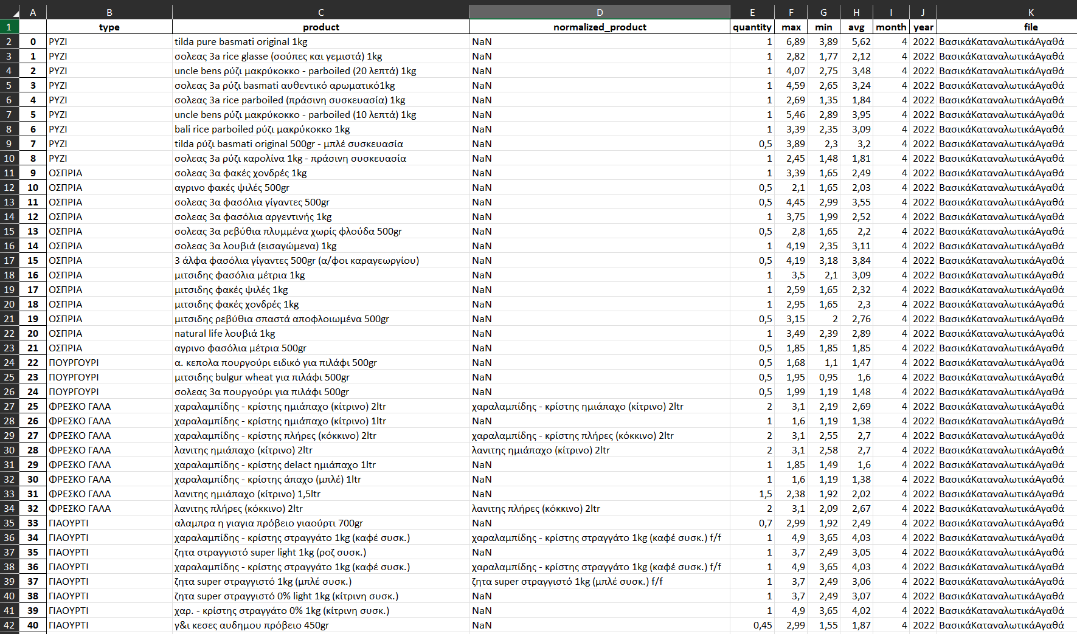
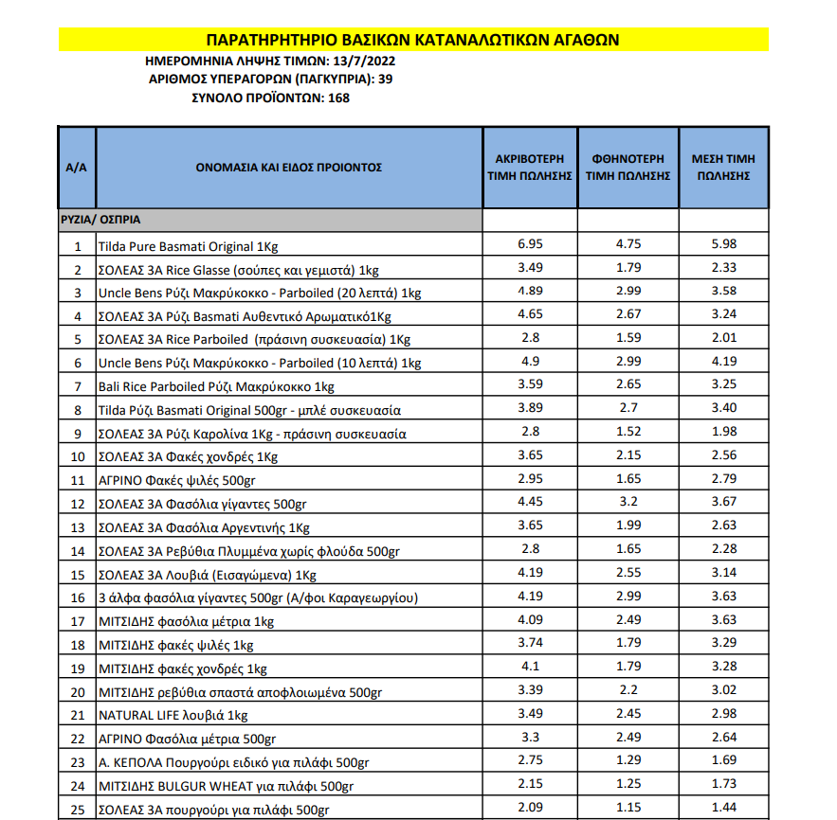
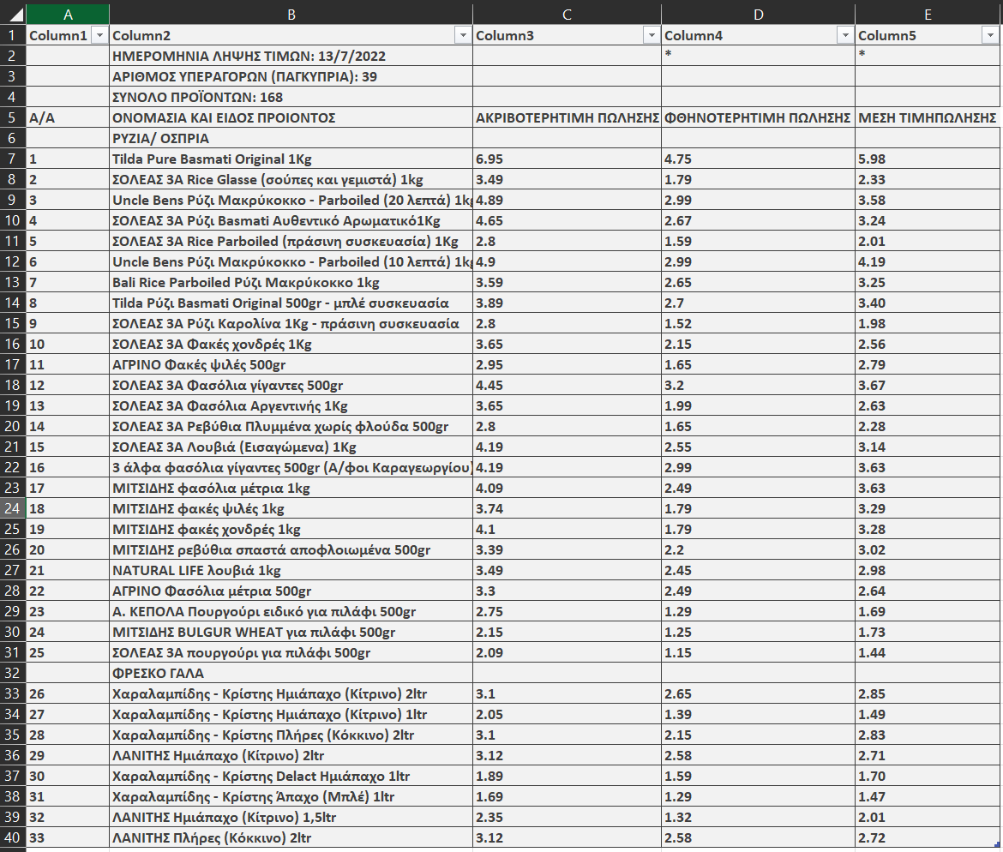
Preprocessing

Slide 9
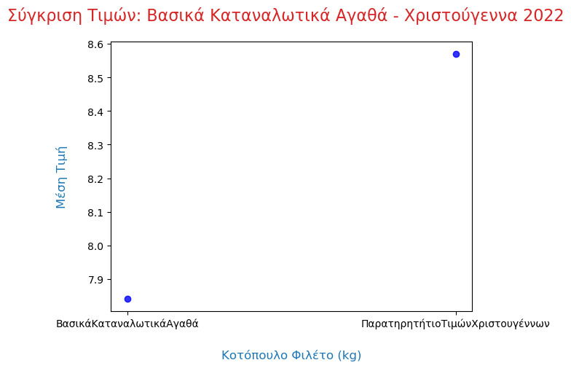
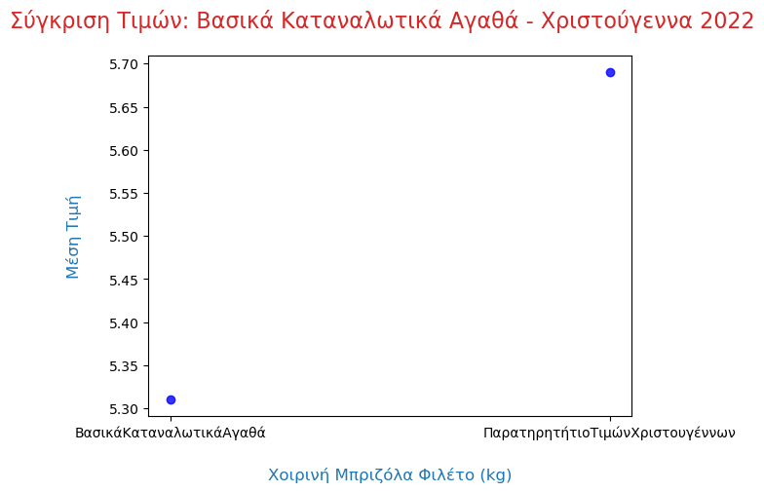
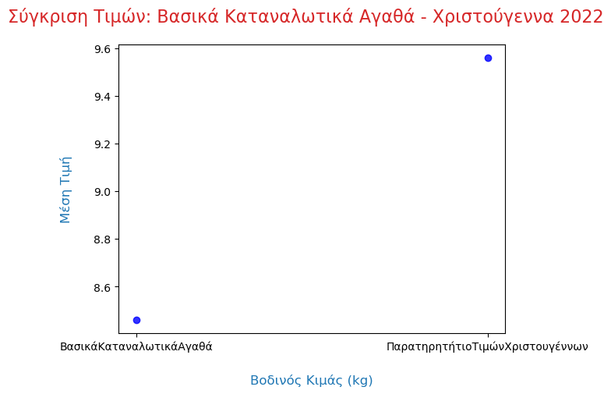
Exploratory Data Analysis (EDA)
Comparing Basic Consumer Goods to Seasonal products → Christmas

Slide 10
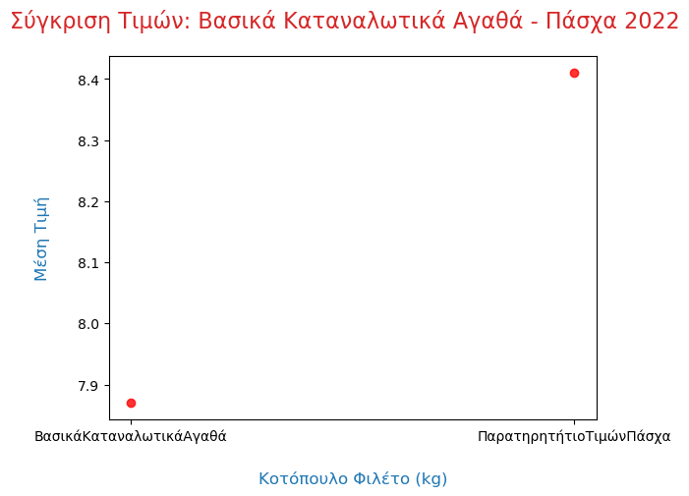
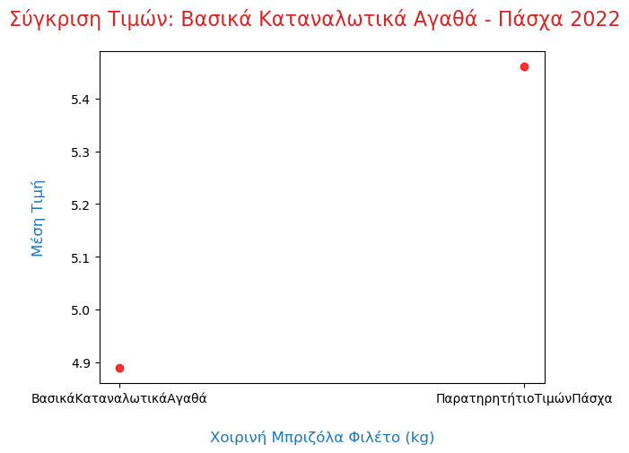
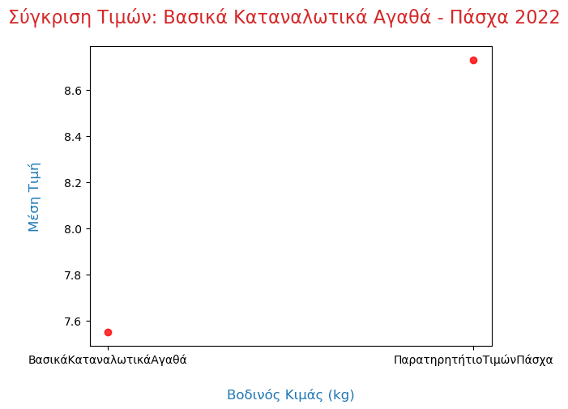
Exploratory Data Analysis (EDA)
Comparing Basic Consumer Goods to Seasonal products → Easter

Slide 11
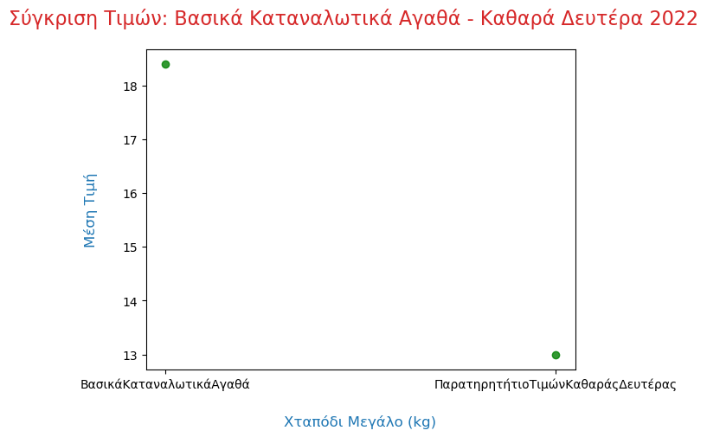
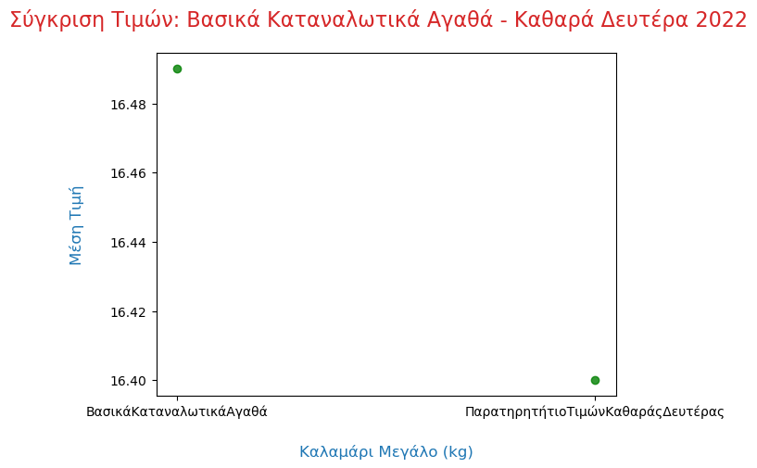
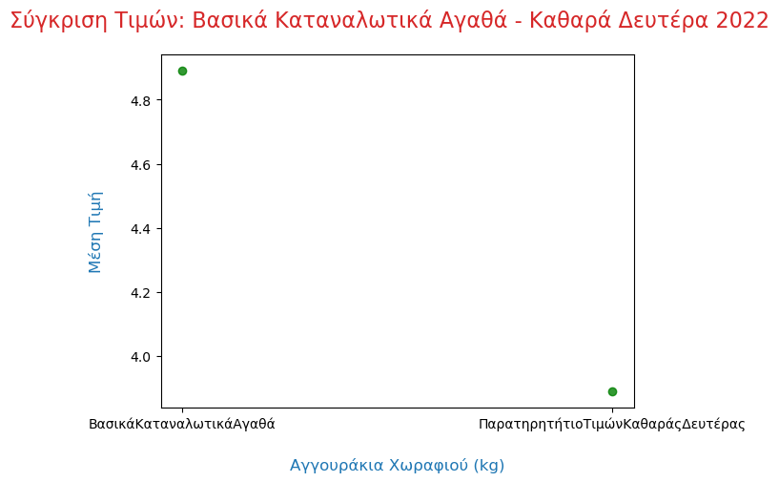
Exploratory Data Analysis (EDA)
Comparing Basic Consumer Goods to Seasonal products → Green Monday

Slide 12
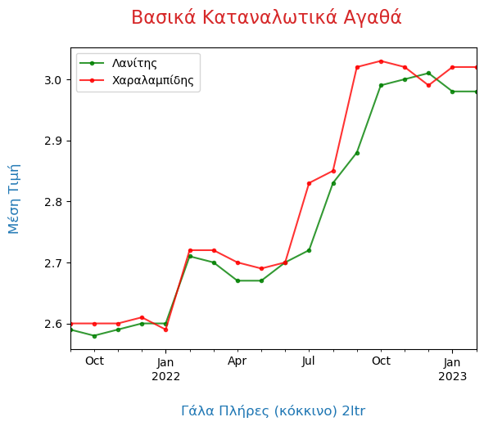
Exploratory Data Analysis (EDA)
Milk Market → Brands Comparison

Slide 13
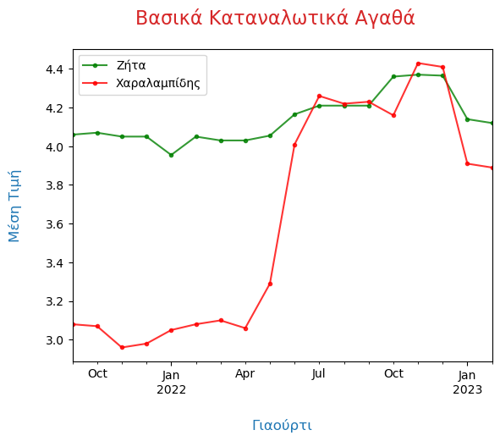
Exploratory Data Analysis (EDA)
Yogurt Market → Brands Comparison

Slide 14
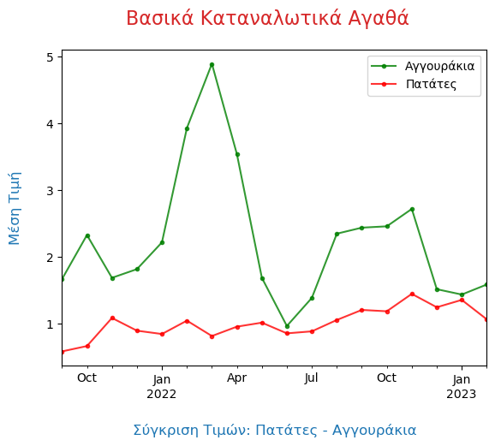
Exploratory Data Analysis (EDA)
Cucumber – Potatoes

Slide 15
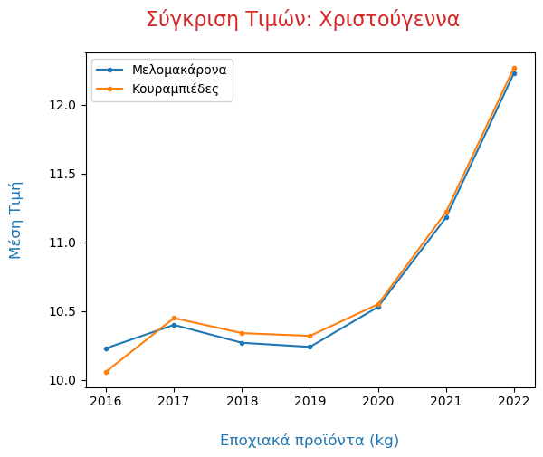
Exploratory Data Analysis (EDA)
Melomakarona – Kourambiedes

Slide 16
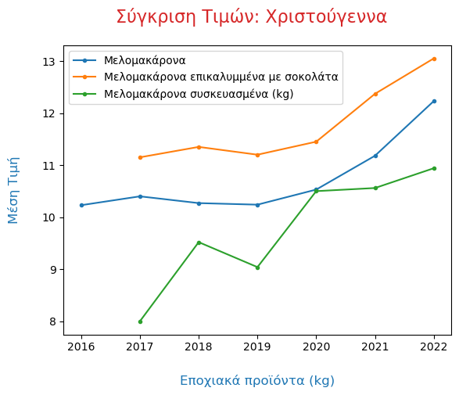
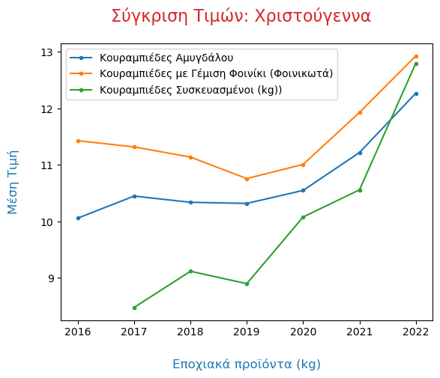
Exploratory Data Analysis (EDA)
Melomakarona
Kourambiedes

Slide 17
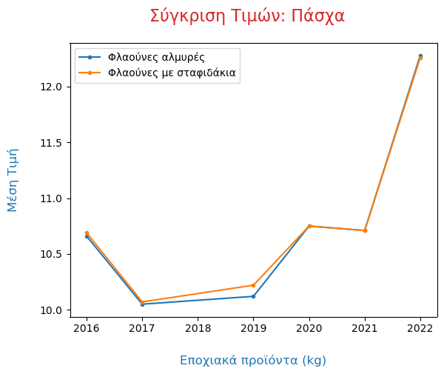
Exploratory Data Analysis (EDA)
Flaounes

Slide 18
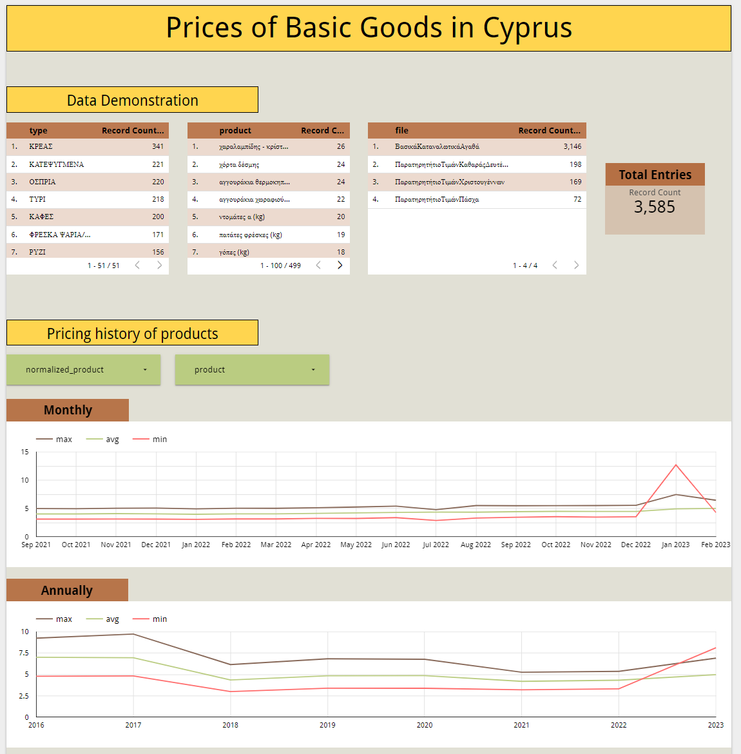
Dashboard

Slide 19
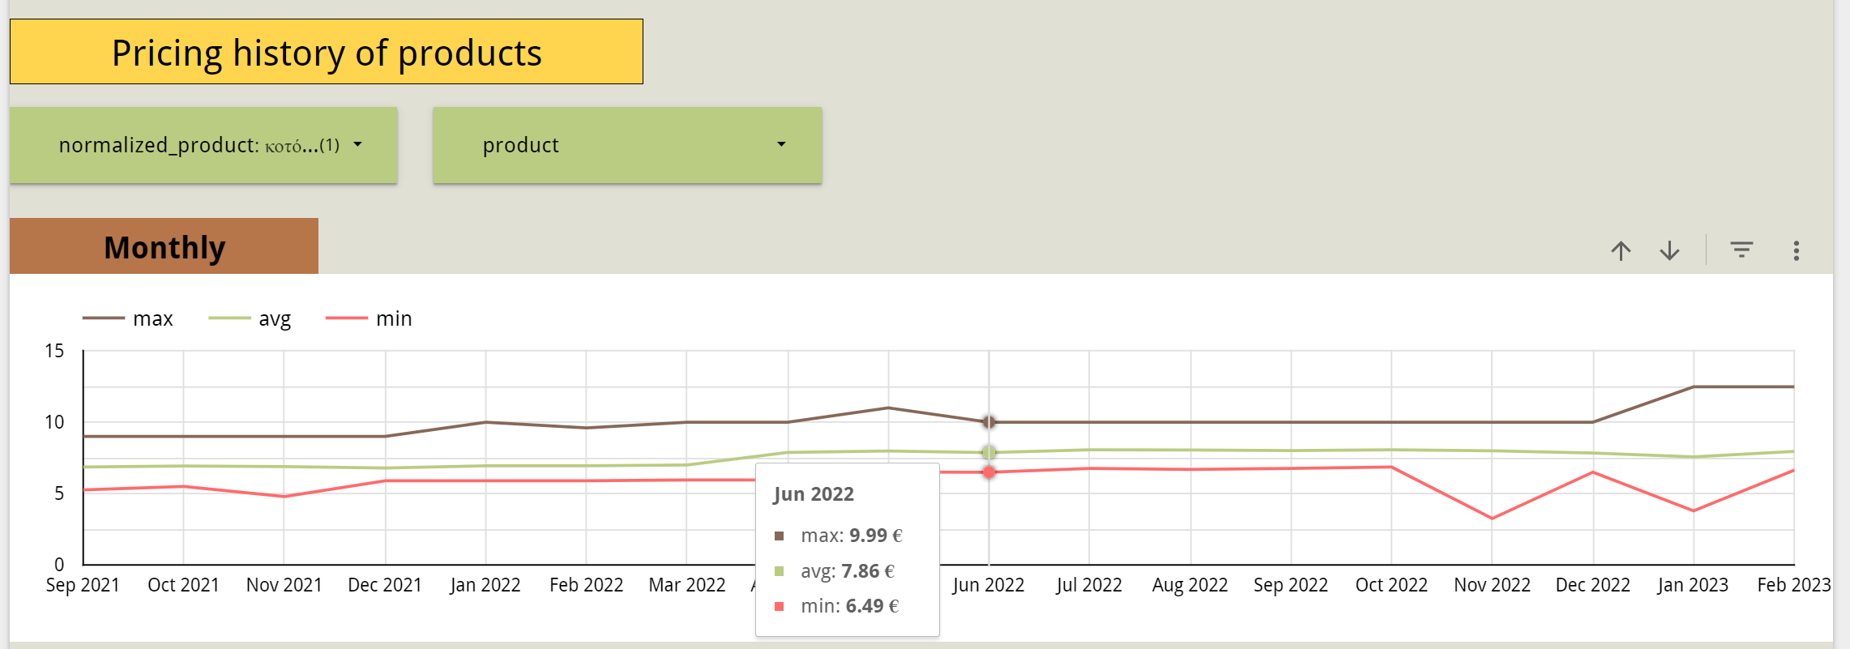
Dashboard
Selecting normalized_product:

Slide 20
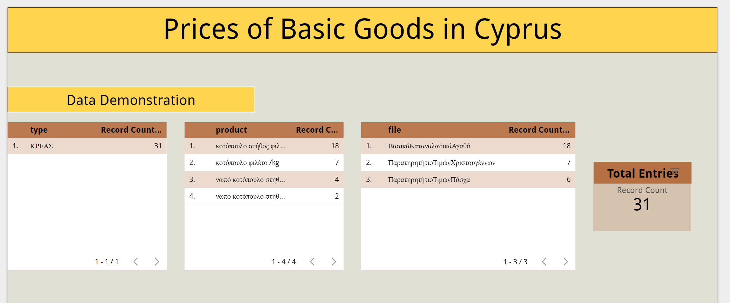
Dashboard
Interactive reaction

Slide 21

Thank you for your attention
Any questions ?

